Slide 1
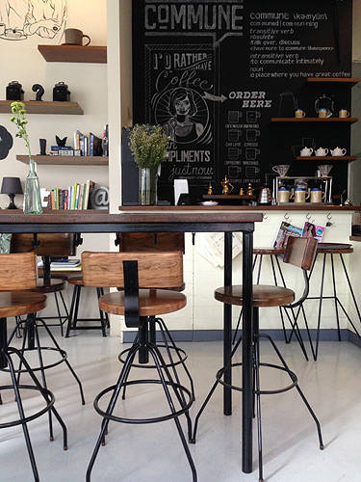
Coffee_Shop Website
To :
Fahim Faisal
Lecturer
Course : Software project III
Course code : CSE316
Dept. of CSE
Daffodil International University
By:
Tanha Tul Tasnim
Id : 221-15-5626
Sec : 61_V
Semester : Spring2024
Dept. of CSE
Daffodil International University

Slide 2
introduction
Nobody likes waiting in line when they need to get their morning caffeine fix. Our Coffee_Shop app provides service though online using webpage and real time . Companies or organizations employee can easily order coffee using the page if they unable to visit the shop.
Customers are our main priority. Fulfilling
their thoughts, choices, taste are our main purpose.

Slide 3
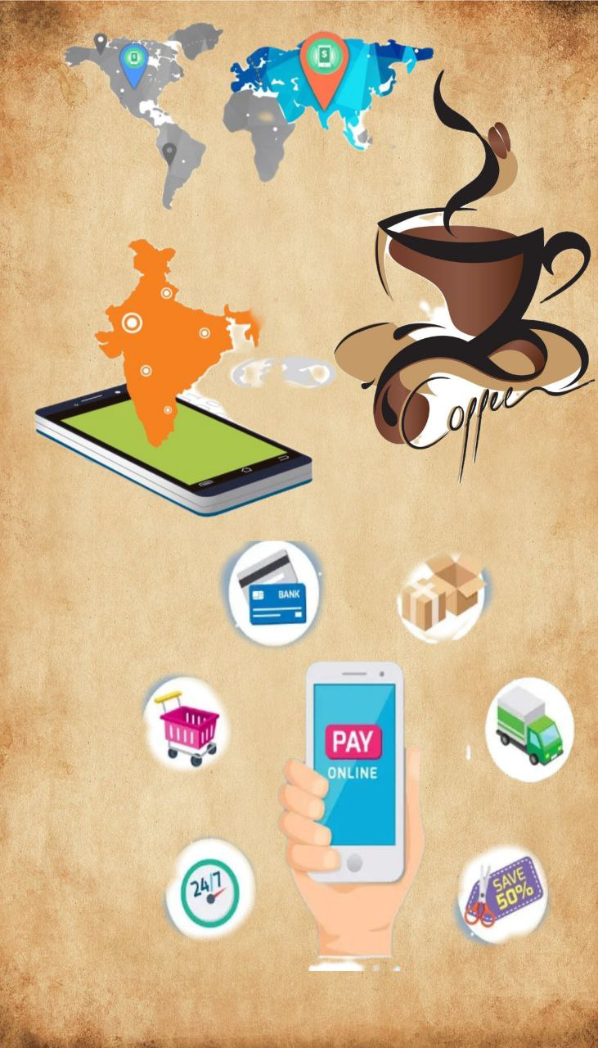




Features for the Coffee Shop app
Pre-Ordering
This feature allows clients to skip the queue and have the coffee ready for arrival.
App Payments
It include reducing the reliance on cash, promoting efficiency in operations, increasing convenience of payments, and improving the quality of financial reports.
Rewards Program
Every time customers buy coffee, they earn virtual ‘stamps’. Collecting these stamps, or rewards can help customers earn discounts or even get the next coffee free of charge!
Location Map

Slide 4
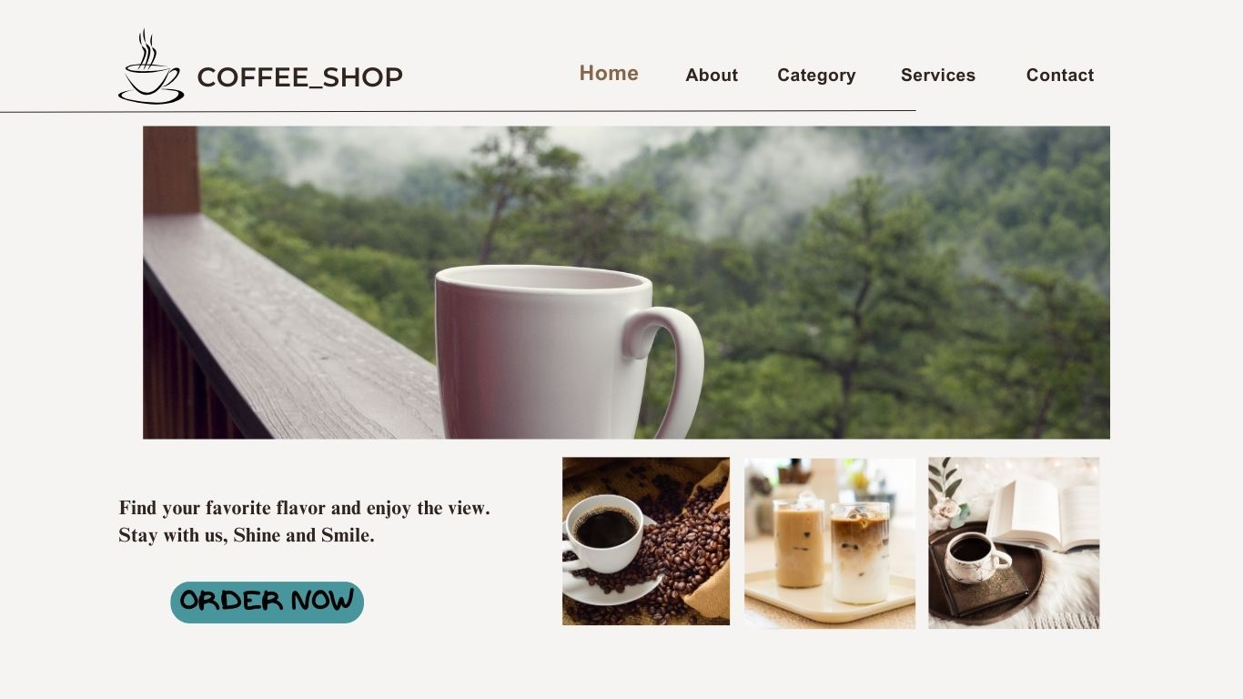

Slide 5
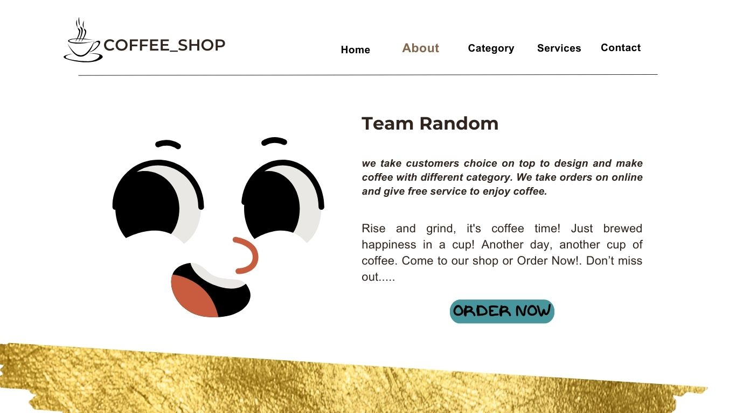

Slide 6
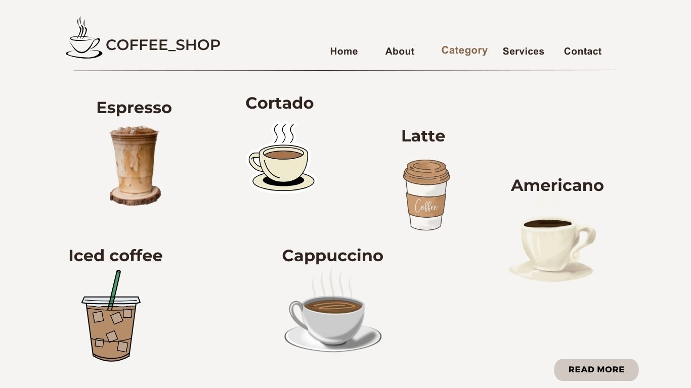

Slide 7
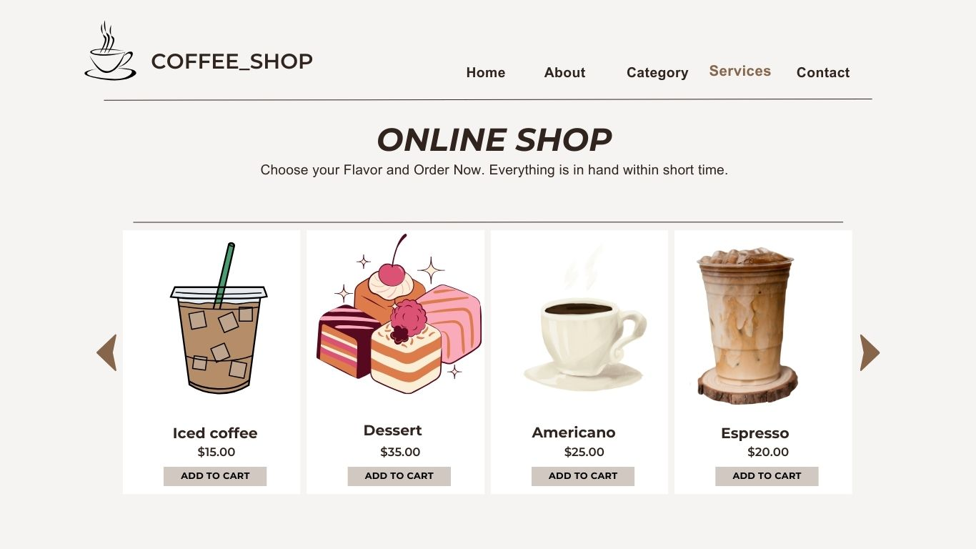

Slide 8
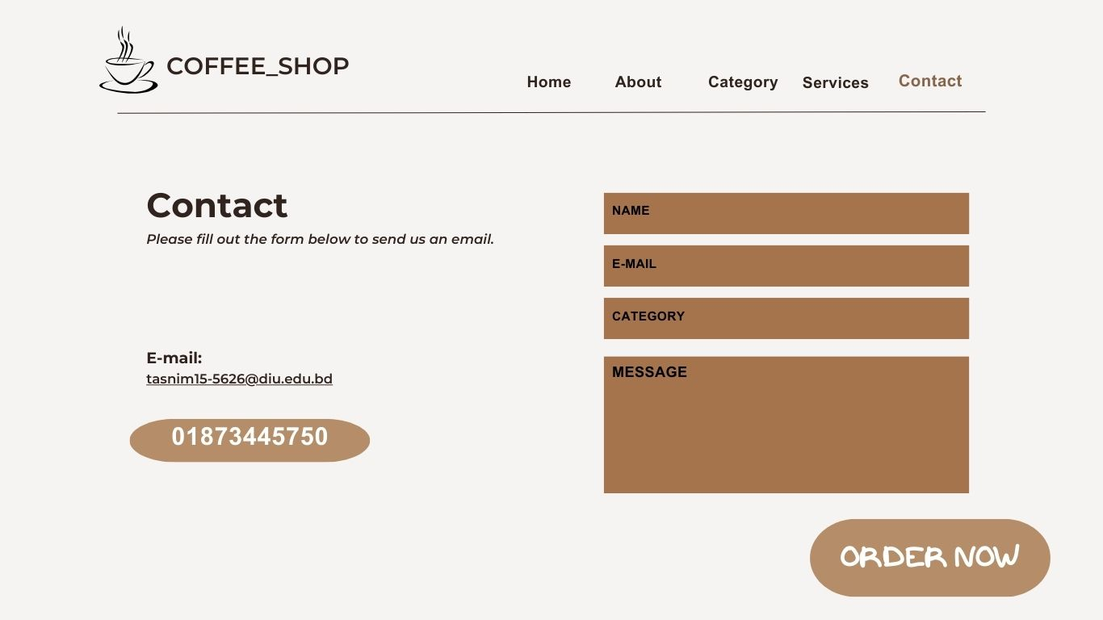

Slide 9
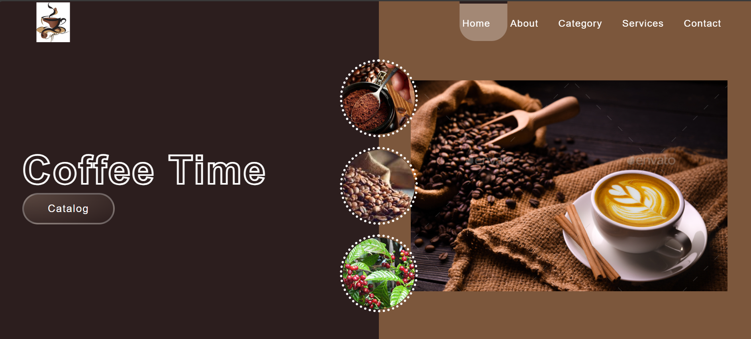
Web Front Page

Slide 10

Advantage :
Easy, fast and comfortable
Increased customer loyalty
Safer and healthier
Highly customizable and less chance for errors
Staffing cost is reduced
Customer don’t have to wait in line to order
Increase repeat visits and increase order sizes.

Slide 11
Disadvantages :
Data security
Risk of losing customers' data
Chances of a technical problem in the system
Mismatch data of orders, customers and drivers
Difficulty in choosing the right developer to develop a customized system

Slide 12


Steps To Develop A Coffee Shop App
Brainstorm & Define Business idea
Conduct Market Research
UX/UI Design & Development
Coffee App Testing
Launch & App Maintenance

Slide 13
Conclusion :
The Coffee Shop web has built using html and css combination and the prototype is the model of this website. It is a service platform, provide service using both real time and online periodic time .The coffee shop website code has uploaded in git-hub .
Git-hub link : https://github.com/Tttasnim?tab=repositories
Prototype link : https://www.canva.com/design/DAGFWZbGG84/rVJfOFN1yCWpHElxVOfPdQ/edit?utm_content=DAGFWZbGG84&utm_campaign=designshare&utm_medium=link2&utm_source=sharebutton

Slide 14
Thank you

